Slide 1



SPEAKEZ
AI Language Translator
Kaali Lovell | Pavan Polireddy | Rakesh Tirumala
Steve St Fleur | Tanvi Prakash Gavali | Venkat Sai Pallapu

Slide 2

AGENDA
1- Recap | 2- Project Overview | 3- Backlogs | 4- Team Metrics | 5- Product
Team Roles & Responsibilities Improvements Project Description Team Working Agreement Personas | MVP Languages & Tools Algorithms Diagrams Sprint 1 Recap | Product Backlog Sprint 2 & 3 Summary Sprint 3 Backlog Test Cases Story Completion | Team Velocity Burndown Charts Retrospective | Application Screenshots API Live Application Demo

Slide 3


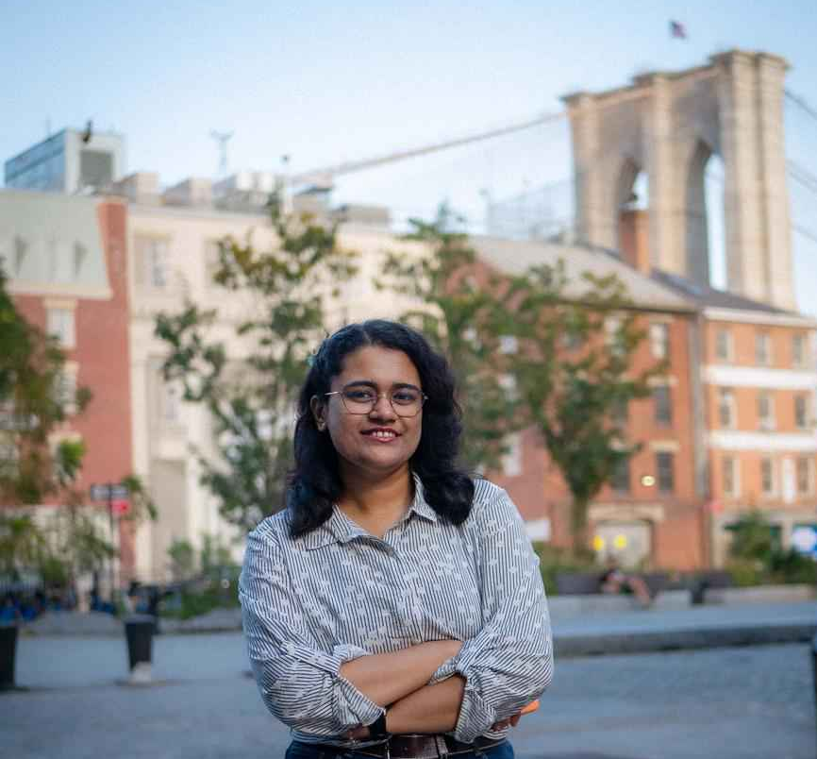

TEAM ROLE & RESPONSIBILITIES
Rakesh Tirumala
Team Lead/ Developer
Tanvi Prakash Gavali
Scrum Master/ Developer
Kaali Lovell​
Tester/ Product Designer

Slide 4
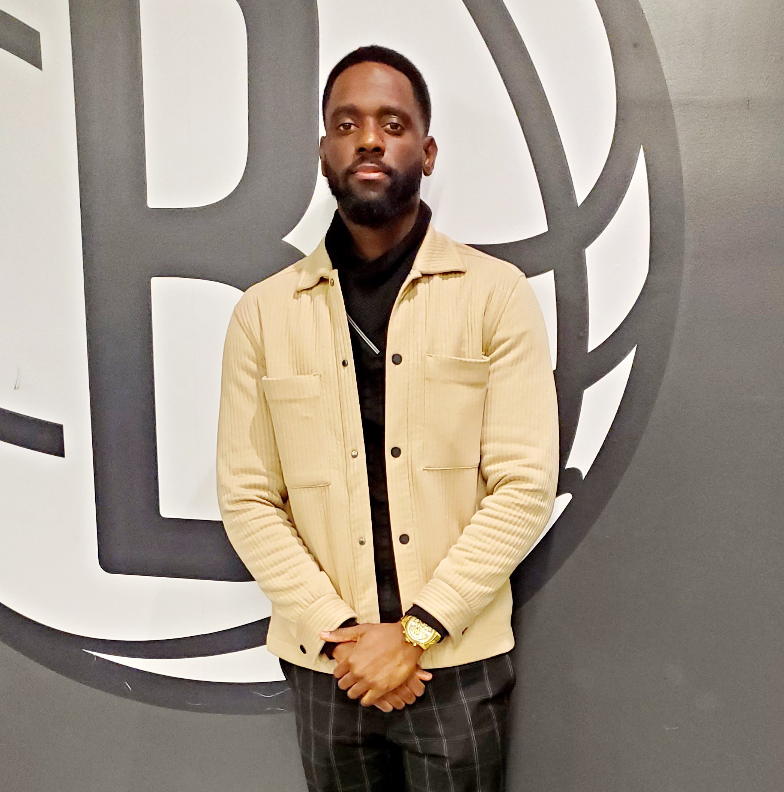
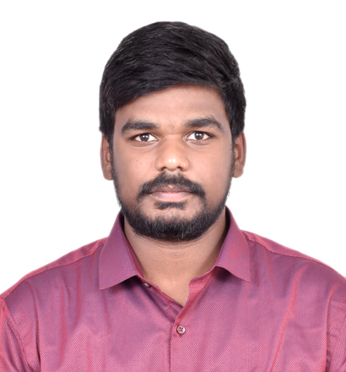

TEAM ROLE & RESPONSIBILITIES
Steve St Fleur
Developer
Venkat Sai Pallapu​
Developer
Pavan Polireddy
Developer​

Slide 5
Improvements
User Stories:
For the acceptance criteria, use the "Given, When, Then" syntax.
No need to include "Feature" section if it does not relate to the application.
Velocity:
No need to include the historical completed-to-committed graph data, nor the completed-to-committed ratio. The velocity is the team's completed points.
Cumulative Flow Diagram and Burndown chart:
Describe charts more accurately when presenting.

Slide 6

PROBLEM STATEMENT
Understanding foreign languages is often a challenge, as each language has its own unique structure, nuances, and meanings. Effective communication with native speakers becomes difficult without proper understanding, yet mastering every language is nearly impossible. To address this issue, we aim to create an application that helps bridge the communication gap by converting audio into transcriptions in multiple languages, enabling people to understand and engage in conversations more easily.

Slide 7
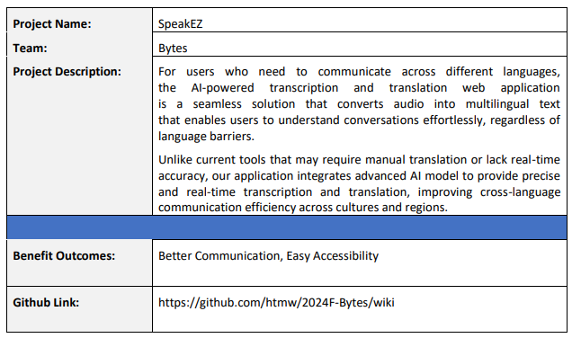

PROJECT DESCRIPTION

Slide 8
TEAM WORKING AGREEMENT
Communication:
The team will communicate with each other through Zoom and WhatsApp.
Google Docs will be utilized for collaborative document editing, sharing resources, and taking notes during team discussions.
Team members should alert the team in advance if they are unable to join a Zoom meeting.
Team members are expected to provide regular updates on task progress and promptly communicate any obstacles or delays to the group.
Team members are encouraged to actively participate in discussions, providing feedback and support as needed.
During all discussions, team members should listen carefully, speak clearly, and stay on topic to avoid confusion
Each team member should complete all assigned work before the deadline. If they are struggling with a task, they should contact the team as soon as possible to resolve the issue. Failure to complete work before the deadline can negatively affect the team’s project timeline.

Slide 9
TEAM WORKING AGREEMENT
Work Division & Participation:
Jira, and GitHub will be used to track and divide all tasks.
The entire project should be divided into equal parts, and all team members should be given equal responsibility.
If a team member is not participating to the level the other members are, the team leader is permitted to assign necessary tasks to that member.
Each team member is responsible for their assigned tasks and their contribution to the overall success of the project.

Slide 10
TEAM WORKING AGREEMENT
Meetings:
Regular team meetings will be scheduled twice a week on Sundays at 2:00 pm and Thursdays at 5:30 pm via zoom to review individual and collective progress. Failing to join these meetings will negatively affect the group.
If unable to attend a scheduled meeting, team members should inform the group in advance.
In urgent situations, additional meetings may be arranged with at least 24 hours’ notice.
Meeting agendas will be sent at least 24 hours prior to the meeting.
Meetings will commence and conclude on time, with members expected to join 2 minutes prior to the start.
All team members are required to have their Zoom cameras open during the meetings. They are required to show respect, actively listen, and participate by sharing feedback or suggestions.
Team agrees to follow these agile practices throughout the project:
Meet at the beginning of each sprint to discuss tasks for the upcoming sprint.
Meet at the end of each sprint to present the completed work and gather feedback.

Slide 11
TEAM WORKING AGREEMENT
Respect and Professionalism:
All communication and interaction within the team will be conducted with respect; diverse viewpoints and inputs should be appreciated.
Feedback should be constructive and centered on the project and not on personal traits.
If a member disagrees with a decision, they can request a review at the next team meeting.
The team aims to create a welcoming space where everyone feels comfortable sharing their ideas
Any disagreements should be addressed openly and respectfully within the team. If an internal resolution is not possible, the team will seek advice from the professor.

Slide 12
TEAM WORKING AGREEMENT
Definition of Done (MVP DoD) for the Language Translator App:
The application can transcribe the given audio into text without error.
The application can successfully translate the transcribed audio to the specified language without errors.
A user is able to upload or delete an audio file to the application without errors.
Codes have been reviewed and approved by all team members.
The app has been manually tested for usability and performance.
Codes are documented with comments where necessary.

Slide 13
TEAM WORKING AGREEMENT
Definition of Done (Sprint DoD) for the Language Translator App:
All required presentation slides are complete
The Wiki Page documents are posted and all links are responsive
The retrospective, sprint planning, presentation, and demo videos are recorded and posted
The Technical Paper and User Manual are complete (later Sprints)
Definition of Done (User Story DoD) for the Language Translator App:
Code has been reviewed by all team members
Code has been tested by a team member

Slide 14
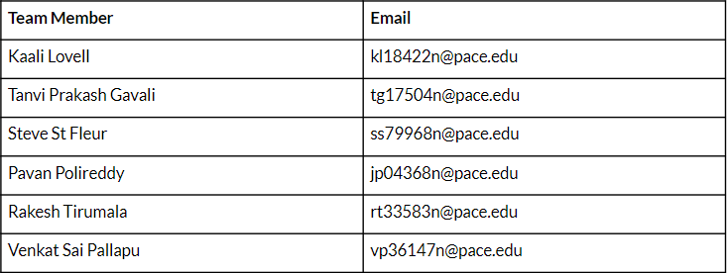
TEAM WORKING AGREEMENT

Slide 15

PERSONAS

Slide 16
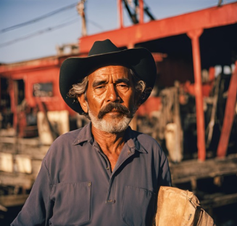
JOSÉ RODRIGUEZ, DOCKS WORKER
Demographics:
Age: 53
Gender: Male
Location: Louisiana, USA
Education: High school diploma
Experience: 15+ years
Skills and Qualifications:
Forklift License
Management in handling and securing cargo using forklifts
Excellent team worker, organized, and physically capable
Goals and Needs:
José is originally from Mexico but has relocated to USA for better working opportunities for his children. He can understand very little English as most of his coworkers speak Spanish as well. During his old age, he started having frequent visits to the doctors where they speak in English with him, which he has difficulty understanding. He does not want to burden his children with the task of translating, and wants to retain confidentiality between himself and his doctor. It is also expensive to hire professional translators - beyond his budget. Jose is looking for an application where he can converse with the doctors without any communication hindrances, and keep transcripts as part of his medical record - both before and after translation.

Slide 17

ANJALI CHITRE, LAWYER
Demographics:
Age: 27
Gender: Female
Location: Edinburgh, UK
Education: LLM in International Law
Experience: 4+ years
Skills and Qualifications:
Skilled in conducting in-depth research regarding international legal issues
Proficient in explaining legal concepts and mediating in legal cases
Professional, showcasing confidence and problem solving skills.
Goals and Needs:
Anjali’s job is to provide legal advice to multinational corporations who need to comply with different regulations for both their U.K and Swedish subsidiaries. To not disclose business information and legal strategies to a 3rd party, Anjali would like an application which can transcribe and translate discussion during meetings without breaching confidentiality or having to create further confidentiality agreements with translators.

Slide 18

NICOLE SCHULER, EXECUTIVE ADMINISTRATIVE ASSISTANT
Demographics:
Age: 27
Gender: Female
Location: Toronto, CA
Education: Bachelors of Business Administration (BBA)
Experience: 1 years
Skills and Qualifications:
Proficient in Excel, Microsoft Office, Outlook, Google Workspace
Certified Administrative Professional (CAP)
Excellent organizational, administrative, and interpersonal skills
Goals and Needs:
Nicole is originally from NYC but has relocated to Canada for work. Nicole has to attend daily meetings and transcribe the meetings for her higher-ups. Some of her co-workers switch between French and English in the meetings which frustrates Nicole since her native language is English and she has no experience with French. Nicole is looking for a tool that will help her efficiently transcribe the meetings and also assist with translating the French terms.

Slide 19
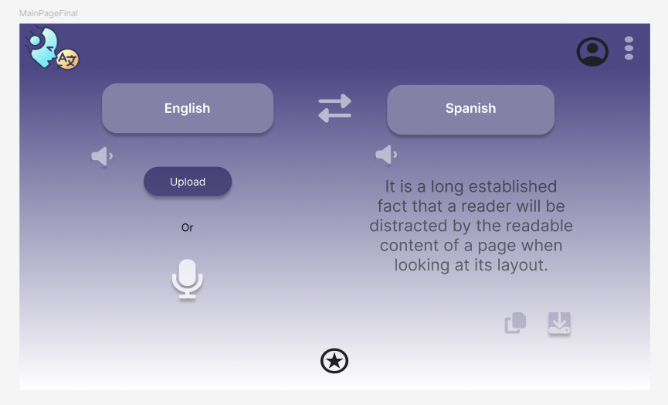
MVP Design
Upload Audio
User should be able to upload a .mp3 file from their computer.
The application should not allow any other file type to be uploaded.
User should be able to remove the audio file once it was uploaded.
Record Audio from Mic
User should be able to use our application, SpeakEZ, to record audio.
Transcribe Audio
The application should transcribe the audio that was uploaded by the user.
Language Selection:
User should be able to select the language they want to translate their transcription into.
Translate Transcription
The application should translate the transcription in the language the user desires.

Slide 20













TECHNOLOGIES
Programming Languages and Frameworks | Libraries | Tools | Deployment
SpeakEZ uses these applications for the dynamic user interface. | Vite- used to build and develop the front end for SpeakEZ MaterialUI- React component for the user interface TailwindCSS- CSS framework for creating responsive designs HuggingFace- assists with building AI powered applications | GitHub- remote version control & collaborative development VSCode- code editor Figma- application brainstorming design Jira- project management | Firebase database is used to store the user's translated and transcribed text.
HTML5
CSS
Vite
HuggingFace
GitHub
VSCode
Firebase
JavaScript
React
MaterialUI
TailwindCSS
Figma
Jira

Slide 21

ALGORITHMS
The application should be able to take audio as input and convert it into the desired language. To achieve this, we need an AI model for automatic speech recognition and speech translation. So, the most suitable neural network to use in order to perform this task is a Transformer.

Slide 22
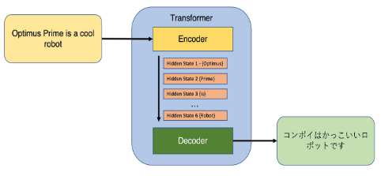
ALGORITHMS
A transformer is a neural network architecture especially designed for processing sequential data like natural language processing (NLP).
They usually use an encoder-decoder structure but make use of attention mechanism in order to capture relationships between elements in a sequence. Unlike RNNs, transformers process data in parallel which makes them faster and more scalable.

Slide 23
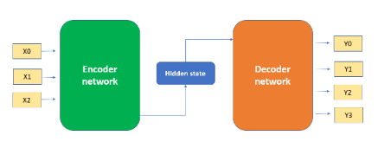
ALGORITHMS
In the encoder-decoder structure, the encoder processes the input data, which can be text, audio, etc., and generates encodings. The decoder takes these encodings, uses the derived context, and generates the output sequence.

Slide 24
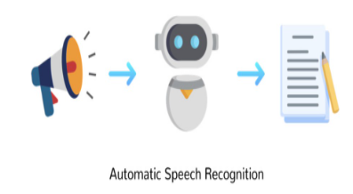
ALGORITHMS
Whisper is a transformer based on the encoder-decoder structure. It was trained on 680,000 hours of labelled speech data. The model can perform both speech recognition and speech translation.

Slide 25
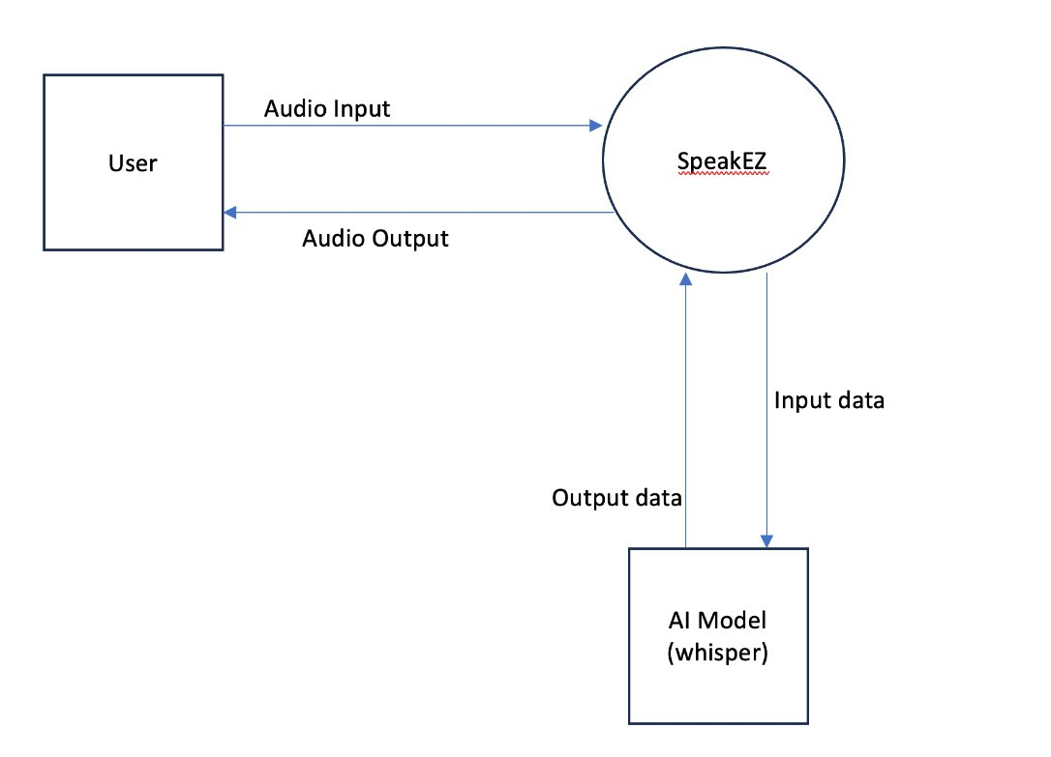
Context Diagram

Slide 26
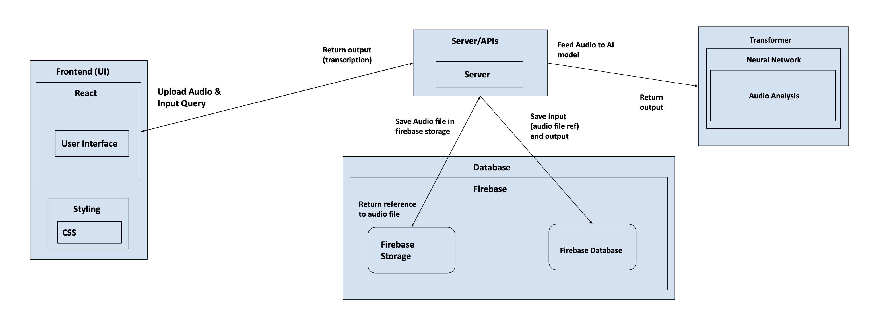
Architecture Diagram

Slide 27
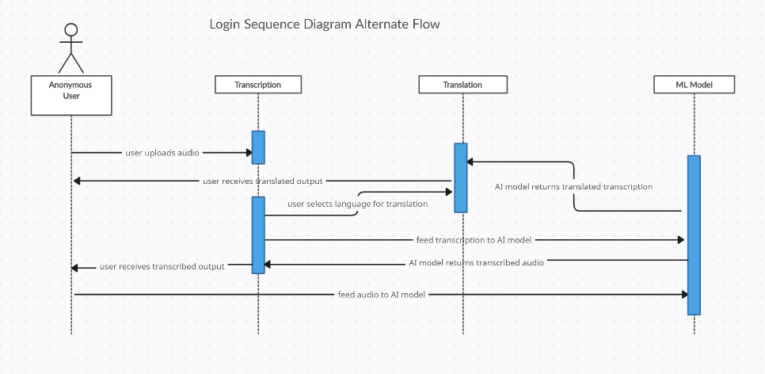
Sequence Diagram

Slide 28
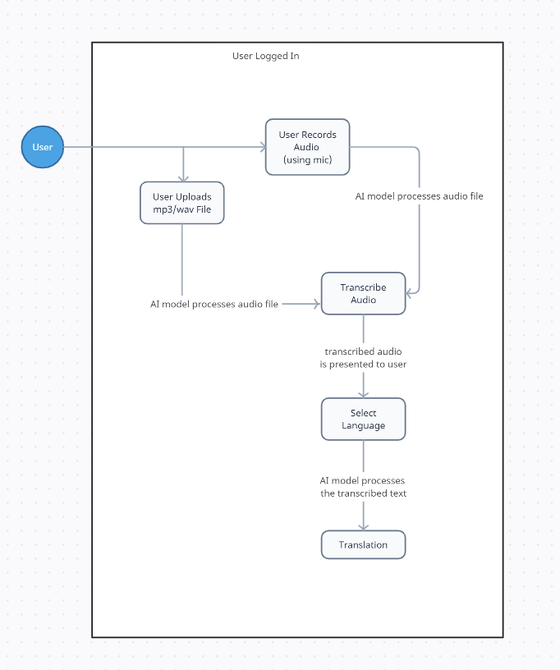
State Diagram

Slide 29
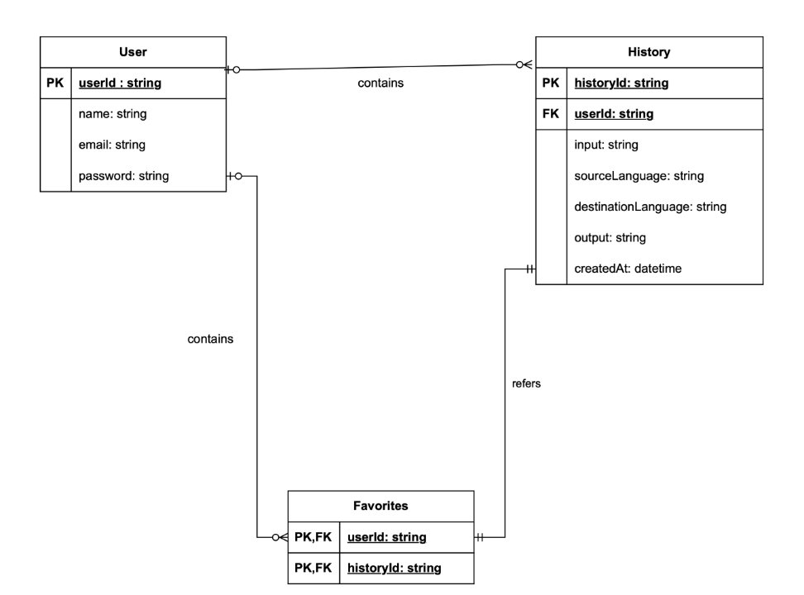
Class Diagram

Slide 30
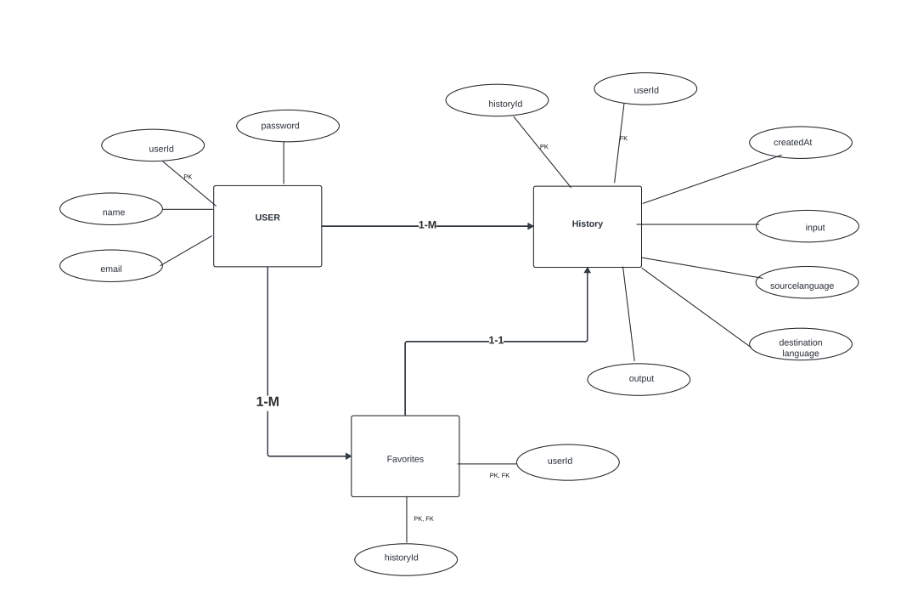
ER Diagram

Slide 31
Sprint 2 Recap
Updated the UI for the SpeakEZ application
Upload audio file with maximum file size of 20MB
Transcribe uploaded audio file in user's input language
Translate user's transcription into English.
Update user sign-in drop down as well as "Create Account" page
30 Story Points
Completed 66% of the Story Points

Slide 32
Sprint 3 Recap
The following features were implemented into our application for Sprint 3:
Audio input time limitation
Dropdown for language selection
Translation of text into other languages besides English
Integrated a firebase database to allow users to create an account and login with SpeakEZ
History page so users can see all past transcription and translation results
Favorite button for saving the user's results they determine are of highest priority
My Team Page and Help & Support Access Page
Toggle button for Light/Dark mode for the UI
Completed 100% of the Story Points

Slide 33
Product Backlog
User Story ID | Point estimated | As a(n) | I want | So that | Feature
LTA-115 | 2 | Admin | to have an "Upload" button. | I can easily select and upload a file for translation. | Upload Button
LTA-117 | 3 | Admin | to see the progress of a file upload for translation . | I know when the upload is completed and the file is ready for translation. | Progress Indicator
LTA-146 | 3 | Admin | to be notified about the progress of the audio file transcription. | I know the transcription is complete and ready for use. | Progress Indicator
LTA-145 | 2 | Admin | to copy the transcribed text from the text box,. | I can use the transcription in other applications. | Copy Button
LTA-144 | 5 | Admin | the transcribed text to be displayed in a text box after I upload an audio file. | I can view the transcription easily. | Text box
LTA-143 | 3 | Developer | to ensure the Worker handles and processes messages from the Whisper model in correct order. | the transcription tasks are processed accurately and sequentially. | Worker Queue System
LTA-142 | 3 | Developer | to send the audio data to the Whisper model for transcription. | I can obtain the transcribed text from the audio. | Whisper Model
LTA-141 | 3 | Developer | to be able convert audio files into audio data. | the data can be processed for transcription by the Whisper model. | Whisper Model
The User Story ID Number is our Jira Ticket ID

Slide 34
Product Backlog
User Story ID | Point estimated | As a(n) | I want | So that | Feature
LTA-140 | 5 | Developer | to implement worker functionality to handle incoming messages from the Whisper model. | the system can process audio transcription requests efficiently in the background. | Worker Functionality
LTA-139 | 5 | Developer | to configure the integration with the AI model to process user audio or file input and display the translated output. | users can submit non-text inputs and receive an accurate translation. | AI Model
LTA-136 | 1 | Admin | to see a header at the top of the page with a logo on the left. | I can easily identify the tool's branding. | Header with Logo
LTA-125 | 3 | Admin | a dropdown menu for selecting the input language. | I can choose any available language for translation. | Dropdown Menu
LTA-123 | 3 | Admin | to select the languages for translation before recording audio. | I can ensure the translation is done between my preferred languages. | Dropdown Menu
LTA-121 | 2 | Admin | to be able to confirm or cancel my voice input after recording. | I can ensure the correct input is used for translation. | Confirm / Cancel buttons
The User Story ID Number is our Jira Ticket ID

Slide 35
Product Backlog
User Story ID | Point estimated | As a(n) | I want | So that | Feature
LTA-138 | 5 | Admin | to configure the Firebase database by following the provided UML diagram | the database structure aligns with the system’s requirements and functions efficiently. | Configure Firebase Database Based on UML Diagram
LTA-118 | 2 | Customer | to be informed if the file I upload exceeds the size limit | I can upload a smaller file or take appropriate action. | File Size Limitation
LTA-116 | 1 | Student | to see an error message when I upload an unsupported file type | I am informed about the file type restrictions and can take corrective action. | Error Message for Unsupported File Types
LTA-127 | 3 | Teacher | to quickly copy the translated text | I can paste it into other applications. | Copy Translated Text
LTA-119 | 3 | Diplomat | to have a "Microphone" button | I can record my voice input for translation without typing. | Microphone Button for Voice Input
LTA-124 | 2 | Lawyer | to be informed if my audio recording exceeds a certain time limit | I can manage the length of my input and avoid losing the recording. | Audio Input Time Limitation
LTA-120 | 5 | Doctor | the system to accurately translate my recorded audio into another language | I can understand the content in a different language. | Accurate Translation of Audio Input
LTA-122 | 2 | Elderly user | to see visual indicator during the audio recording | I know when my voice is being recorded. | Audio Recording Indicator
The User Story ID Number is our Jira Ticket ID

Slide 36
Product Backlog
User Story ID | Point estimated | As a(n) | I want | So that | Feature
LTA-126 | 2 | Student | a dropdown menu for selecting the output language | I can receive translations in any language of my choice. | Dropdown for Output Language Selection
LTA-131 | 3 | Multilinguistic | the system to save all my past translations | I can access my full translation history at any time. | Ability to Save All Past Translations
LTA-129 | 2 | Patient | to download the translated text in different file formats (e.g., .txt, .docx) | I can choose the format that best suits my needs. | Supported Formats for Downloaded File
LTA-128 | 2 | Working Professional | a "Download" button next to the translated text | I can download and save the translated content for future use. | Download Button for Translated Text
LTA-151 | 1 | Team | make necessary modifications in our project as per professor’s feedback | we deliver better presentation next sprint | Improvement Feedback from Sprint 1
LTA-149 | 2 | Team Member | update the wiki page with our current deliverable | customers can checkout our current progress for this sprint | Wiki Page for Sprint 2
LTA-148 | 5 | Client | like to know more about the product through a detailed technical paper | I can have documented understanding of the product. | Technical Report
LTA-130 | 3 | Accountant | to be able to reuse my past translations | I can revisit previous translations without re-entering the same text. | Ability to Reuse Past Translations
LTA-137 | 2 | Frequent user | to access my profile and settings through dropdown menus on the right side of the header | I can manage my account and customize my | Dropdown Menus for Profile and Settings
The User Story ID Number is our Jira Ticket ID

Slide 37
Product Backlog
User Story ID | Point estimated | As a(n) | I want | So that | Feature
LTA-132 | 5 | Student | a toggle button to switch between light and dark modes | I can change the interface based on my preference. | Toggle Button for Light/Dark Mode
LTA-133 | 3 | Elder person | my theme preference (light or dark mode) to be saved | I can continue using my preferred mode across different sessions without resetting it. | Persisting Theme Preference Across Sessions
LTA-134 | 3 | Editor | to mark a translation as a favorite by clicking a star icon | I can easily identify and access important translations later. | Marking and Unmarking a Translation as a Favorite
LTA-135 | 5 | Artist | to access my saved favorite translations in a dedicated "Favorites" section | I can easily find and reuse my important translations. | Accessing Favorite Translations
The User Story ID Number is our Jira Ticket ID

Slide 38
Sprint 3 Backlog
User Story ID | Point estimated | As a(n) | I want | So that | Feature
LTA-132 | 5 | Admin | a toggle button to switch between light and dark modes | I can change the interface based on my preference. | Toggle Button for Light/Dark Mode
LTA-133 | 3 | Admin | my theme preference (light or dark mode) to be saved | I can continue using my preferred mode across different sessions without resetting it. | Persisting Theme Preference Across Sessions
LTA-134 | 3 | Admin | to mark a translation as a favorite by clicking a star icon | I can easily identify and access important translations later. | Marking and Unmarking a Translation as a Favorite
LTA-135 | 5 | Admin | to access my saved favorite translations in a dedicated "Favorites" section | I can easily find and reuse my important translations. | Accessing Favorite Translations
LTA-124 | 2 | Lawyer | to be informed if my audio recording exceeds a certain time limit | I can manage the length of my input and avoid losing the recording. | Audio Input Time Limitation
LTA-126 | 2 | Student | a dropdown menu for selecting the output language | I can receive translations in any language of my choice. | Dropdown for Output Language Selection
LTA-138 | 5 | Admin | to configure the Firebase database by following the provided UML diagram | the database structure aligns with the system’s requirements and functions efficiently. | Configure Firebase Database Based on UML Diagram
LTA-131 | 3 | Multilinguistic | the system to save all my past translations | I can access my full translation history at any time. | Ability to Save All Past Translations
The User Story ID Number is our Jira Ticket ID

Slide 39
Sprint 3 Backlog
User Story ID | Point estimated | As a(n) | I want | So that | Feature
LTA-130 | 3 | Accountant | to be able to reuse my past translations | I can revisit previous translations without re-entering the same text. | Ability to Reuse Past Translations
LTA-181 | 5 | Student | to log in with valid credentials or create an account if I am new | I can securely access my personalized data | Ability to Login/ Create Account
LTA-180 | 2 | Admin | access to FAQ and customer support | I can resolve any issue I encounter with the app | FAQ Page
LTA-175 | 5 | Developer | to install the application to a production environment | I can deploy it successfully | Installation Manual
LTA-176 | 5 | Developer | to set up my development environment | I can extend functionalities in the future | Deployment Manual
LTA-177 | 3 | Student | to have a detailed user manual for the application | I am aware of all the functionalities of this application | User Manual
LTA-178 | 2 | Student | To delete the history from the history section | others may not be able to see my translations | Delete Button
LTA-179 | 5 | Lawyer | to translate the output into the language selected from a dropdown | I can easily get translations in my preferred language | Translation Output
The User Story ID Number is our Jira Ticket ID

Slide 40
Sprint 3 User Stories
Key | Summary | Criteria | Points
LTA-124 | As a Lawyer, I want to be informed if my audio recording exceeds a certain time limit, so that I can manage the length of my input and avoid losing the recording |  | 2
 | Given a customer is using the record audio feature When they are recording audio Then they should be alerted if they are exceeding the recording time limit | The system enforces a maximum recording time (e.g., 2 minutes). An error message or notification is shown if the user exceeds the recording limit.
LTA-126 | As a Student, I want a dropdown menu for selecting the output language, so that I can receive translations in any language of my choice |  | 2
 | Given a student wants to translate their transcription When they click the dropdown menu Then they should see a list of output languages so they can translate their work | A dropdown menu is available next to the output field for selecting the output language. The dropdown displays a list of available languages for the user to choose from. The user can select any language from the list as the output language.
LTA-138 | As an Admin, I want to configure the Firebase database by following the provided UML diagram, so that the database structure aligns with the system's requirements and functions efficiently |  | 5
 | Given an Admin wants to configure a Firebase Database When following our provided UML diagram Then they can duplicate our production environment | Implement the database structure in Firebase as per the attached UML diagram Set up collections and documents to match the entities and relationships shown in the UML Verify the database supports the required operations (e.g. create, read, update, delete) Test the Firebase database setup to ensure it meets the system's performance and security standards
The User Story ID Number is our Jira Ticket ID

Slide 41
Sprint 3 User Stories
Key | Summary | Criteria | Points
LTA-134 | As an Admin, I want to mark a translation as a favorite by clicking a star icon, so that I can easily identify and access important translations later |  | 3
 | Give an Admin wants to mark a translation as favorite When they click the favorite icon Then the icon turns a solid color and their translation is saved under favorite | A favorites(star)icon is displayed at the bottom of each translation Clicking the star icon marks the translation as a favorite A visual change(e.g. the star turns solid) occurs when a translation is marked as a favorite Clicking the star again unmark the translation as a favorite, and the visual indication reverts
LTA-131 | As a multilinguistic, I want the system to save all my past translations, so that I can access my full translation history at any time |  | 3
 | Given a Multilingustic wants to review a past translation When they click on the "Show History" button Then all of their past translations appear for their review | The system automatically saves all translations made by the user. Users can access their full history of past translations from a dedicated section (e.g., "Translation History"). Past translations are stored persistently across sessions, allowing users
LTA-135 | As an Admin, I want to access my saved favorite translations in a dedicated "Favorites" section, so that I can easily find and reuse my important translations |  | 3
 | Given an Admin wants to access a past translation they marked as Favorite When they click the "Favorite" button Then they are shown their past translations that they marked as favorites | Marked favorite translations are saved in a "Favorites" section for easy access Users can open the "Favorites" section to view and reuse their saved translation Unmarked translations are removed from the "Favorites" section
The User Story ID Number is our Jira Ticket ID

Slide 42
Sprint 3 User Stories
Key | Summary | Criteria | Points
LTA-130 | As an accountant, I want to be able to reuse my past translations, so that I can revisit previous translations without re-entering the same text |  | 3
 | Given an accountant wants to reuse their past translations When they click the "Show History" or "Favorite" button Then they will be able to view past translation and use them for their review | Users can view a list of their past translations. Users can select any past translation from the list to reuse it. The system automatically populates the input and output fields with the previously translated content when selected.
LTA-178 | As a Student, I want to delete the history from the history section so that others may not be able to see my past translations |  | 2
 | Given a Student wants to delete a past translation When they want to clear their history Then they can click the delete button in the history section of the application | Should include a delete button in the history section to delete specific translations The delete items should be permanently deleted
LTA-181 | As a Student, I want to log in with valid credentials or create an account if I'm new so that I can securely access my personalized data |  | 5
 | Given a student want to create an account with us When they click Login Then they can follow the instructions to create an account with us | Login: Users can log in using a valid email and password If credentials are incorrect, an appropriate error message is displayed Account Creation: Users can register for a new account by providing an email and password During registration, the system checks for existing accounts with the same email If an account already exits, an error message is displayed
The User Story ID Number is our Jira Ticket ID

Slide 43
Sprint 3 User Stories
Key | Summary | Criteria | Points
LTA-180 | As an Admin, I want to access FAQs and customer support so that I can resolve any issues I encounter with the app |  | 2
 | Given I have a query When I click the FAQ section Then I can reach out to the customer support team to resolve any queries | The user can find the FAQ section in the app's main menu or settings
LTA-132 | As an Admin, I want a toggle button to switch between light and dark modes so that I can change the interface based on my preference |  | 3
 | Given an Admin wants to switch their screen to dark mode When they click "Dark Mode" Then the white part of their screen is transitioned into a darker shade | A toggle button is available to switch between light and dark modes Clicking the button immediately changes the interface colors according to the selected mode
LTA-133 | As an Admin, I want my theme preference (light or dark) to be saved, so that I can continue using my preferred mode across different sessions without resetting it |  | 5
 | Given I am an Admin When I switch my screen to dark mode and then redirect to another page in the application Then my screen should still be on dark mode | The system remembers the user's theme preference (light or dark mode) even after the session ends When the user returns, the interface loads in the previously selected mode.
The User Story ID Number is our Jira Ticket ID

Slide 44
Sprint 3 User Stories
Key | Summary | Criteria | Points
LTA-176 | As a Developer, I want to set up my development environment, so that I can extend functionalities in the future |  | 5
 | Given I am a Student When I want to duplicate this project Then I can use the Deployment Manual to guide me | Guidelines on naming conventions and coding standards used in the application. Instructions on tests and code quality to keep consistency. Documentation to help understand the structure of the codebase. Steps to create and manage branches in the version control system. Steps for merging new features into the main branch Instructions for deploying updates to the production environment
LTA-177 | As a Student, I want to have a detailed user manual for the application, so that I am aware of all the functionalities of this application |  | 3
 | Given I am a Student When I want to use the SpeakEZ application Then I can use the User Manual to guide me | Should have detailed steps on how to use the application as per the customer’s perspective. Should be easy and quick to read and must be well-written. Users should be able to provide feedback and suggest improvements or report issues, including giving a preferrable contact method.
The User Story ID Number is our Jira Ticket ID

Slide 45
Sprint 3 User Stories
Key | Summary | Criteria | Points
LTA-175 | As a Developer, I want to install the application to a production environment so that I can deploy it successfully |  | 5
 | Given I am a Student When I want to install the application Then I can use the Installation Manual to guide me | The manual should include system requirements and software dependencies. It should include instructions for installing tools and software (IDE, version control, dependencies) It should include steps install any missing dependencies. Steps to clone project repository from version control system Instructions on running application locally Steps on how to download, install and start the application Should have a detailed instructions on setting up environment variables and configuration files. It should also include any probably common installation issues and their solutions.
LTA-179 | As a Lawyer, I want to translate the output into the language selected from a dropdown so that I can easily get translations into my preferred language |  | 5
 | Given I am a Lawyer When I need to translate audio into different languages Then I can select the dropdown to do so | A language dropdown menu is available, displaying a list of supported languages. The user can select a preferred language from the dropdown. The system translates the output text into the selected language and displays it in the output field.
The User Story ID Number is our Jira Ticket ID

Slide 46
Test Cases
The User Story ID Number is our Jira Ticket ID
User Key | User Story | Test Key | Test | SubTest | Test Steps | Expected Result | Actual Result | Pass/ Fail
LTA-118 | As a customer, I want to be informed if the file I upload exceeds the size limit, so that I can upload a smaller file or take appropriate action. | LTA-160 | Verify File Upload Size Limit and Error Handling | Confirm that the system supports file uploads up to the specified size limit (e.g., 20 MB). Test uploading files larger than the size limit and verify that an error message is displayed. Ensure the error message is clear and instructs the user on the file size limit. | Browse -> upload mp3 > 20MB | Should throw an error message when file is uploaded more than 20MB. | An error message is displayed if tried to upload a file greater than 20MB. | PASS
LTA-116 | As a student, I want to see an error message when I upload an unsupported file type, so that I am informed about the file type restrictions and can take corrective action. | LTA-161 | Verify Error Message for Unsupported File Types | Test uploading an unsupported file type and verify that an error message appears. Ensure the error message clearly specifies the supported file types. Check the error message format and clarity to ensure users can easily understand the restrictions. | Browse -> upload mp4, doc | Should throw an error message for unsupported file types. | An error message is displayed if mp3 or other unsupported file types are uploaded. | PASS
LTA-127 | As a teacher, I want to quickly copy the translated text, so that I can paste it into other applications. | LTA-162 | Verify Copy Functionality for Translated Text | Ensure a copy button is available next to the translated text. Verify that clicking the copy button copies the translated text to the clipboard. Check that a confirmation message (e.g., “Text copied”) appears when the button is clicked. | Browse -> upload mp3 file > click Translate > click 'copy' icon | Text should be copied to clipboard. Should be able to paste the copied text | Text is copied to clipboard notifying the user. Able to paste the copied text on a notepad. | PASS

Slide 47
Test Cases
The User Story ID Number is our Jira Ticket ID
User Key | User Story | Test Key | Test | SubTest | Test Steps | Expected Result | Actual Result | Pass/Fail
LTA-119 | As a diplomat, I want to have a "Microphone" button, so that I can record my voice input for translation without typing. | LTA-166 | Verify Microphone Button Functionality for Voice Input | Ensure the "Microphone" button is available for starting voice recording. Verify that clicking the "Microphone" button starts recording the user's audio input. Confirm that clicking the button again or reaching a time limit stops the recording. | Click on microphone icon | The "Microphone" button should be visible and accessible to the user for starting voice recording. Clicking should initiate the recording process, capturing the user's audio input. Clicking again or reaching a predefined time limit should stop the recording process. | The "Microphone" button should be visible and accessible to the user for starting voice recording. Clicking should initiate the recording process, capturing the user's audio input. Clicking again or reaching a predefined time limit should stop the recording process. | PASS
LTA-120 | As a doctor, I want the system to accurately translate my recorded audio into another language, so that I can understand the content in a different language. | LTA-172 | Verify "Audio Translation" Functionality | Ensure the system processes the recorded audio and translates it into the selected target language. Verify that the translation is displayed after the processing is completed. Check that the translation accurately reflects the meaning of the original audio input. | Browse -> upload mp3 -> click 'translate' | The system should process the audio input, and display the translated text. | The system processes audio input and displays as translated text successfully. | PASS

Slide 48
Test Cases
The User Story ID Number is our Jira Ticket ID
User Key | User Story | Test Key | Test | SubTest | Test Steps | Expected Result | Actual Result | Pass/Fail
LTA-122 | As a elderly user, I want to see visual indicator during the audio recording, so that I know when my voice is being recorded. | LTA-159 | Verify Visual Indicator for Audio Recording | Ensure a visual indicator (e.g., blinking icon or sound wave animation) is displayed during the audio recording process. Confirm that the indicator stops when the recording is finished or cancelled. Test the responsiveness of the indicator to start and stop with the recording process. | Click on microphone icon | Should be able to see a visual red indicator when clicked on the microphone icon. Verify that the microphone icon reappears when the recording is stopped or canceled, transitioning back from the red indicator. | A red indicator is displayed when clicked on the microphone icon. The microphone icon reappeared when the recording was stopped or cancelled, transitioning back as expected. | PASS
LTA-129 | As a patient, I want to download the translated text in different file formats (e.g., .txt, .docx), so that I can choose the format that best suits my needs. | LTA-169 | Verify File Format Download for Translated Text | Ensure the system provides download options for formats such as .txt and .docx. Verify that clicking the download button generates the translated content in the selected format. Confirm that the content in the downloaded file matches the translated text (correct format and no data loss). | Browse -> upload mp3 file > click Translate > click 'download' icon | When download icon clicked, a .txt file should be generated. | When download icon is clicked, the .txt file is generated. | PASS

Slide 49
Test Cases
The User Story ID Number is our Jira Ticket ID
User Key | User Story | Test Key | Test | SubTest | Test Steps | Expected Result | Actual Result | Pass/Fail
LTA-128 | As a working professional, I want a "Download" button next to the translated text, so that I can download and save the translated content for future use. | LTA-170 | Verify "Download" Button Functionality | Ensure the "Download" button is displayed next to the translated text. Verify that clicking the "Download" button triggers the download of the translated content. Check that the downloaded content matches the translated text exactly. | Browse -> upload mp3 file > click Translate > click 'download' icon > open the downloaded .txt file | The .txt file should contain both the transcribed and translated text. | The .txt contains both text as expected. | PASS
LTA-149 | As a team member, I would update the wiki page with our current deliverable so that customers can checkout our current progress for this sprint | LTA-173 | Check updated wiki page | Test all updated links and if able to download in the required formats such as .xslx, .docs and .mp4 | Wiki link -> click all updated links | All links should allow function as required. | All links are functioning as expected. | PASS

Slide 50
Test Cases
The User Story ID Number is our Jira Ticket ID
User Key | User Story | Test Key | Test | SubTest | Test Steps | Expected Result | Actual Result | Pass/Fail
LTA-137 | As a frequent user, I want to access my profile and settings through dropdown menus on the right side of the header, so that I can manage my account and customize my preferences easily. | LTA-168 | Verify Profile and Settings Dropdown Menus | Ensure the "My Profile" dropdown is available on the right side, providing access to user profile details. Verify the "Settings" dropdown is present on the right side, offering options such as language and theme settings. Confirm that dropdown menus expand when clicked and collapse when not in use. | Browse > upload mp3 file > Translate > Control + Shift + I (developer's tool) | Profile dropdown and settings dropdown should be visible for user to access his profile. It should display correctly across all dimensions when responsive | Profile dropdown and settings dropdown are showing for user to access his profile | Pass
 |  | LTA-174 | Testing Task: Test the responsiveness of dropdown menus across different screen dimensions | Ensure the menu dropdown is displayed correctly and functions as expected across all screen dimensions when in responsive mode. Verify that the dropdown content is fully accessible and that there are no visual or functional issues at various screen sizes, including desktop, tablet, and mobile views. | Browse > upload mp3 file > Translate > Control + Shift + I (developer's tool) Try different screen dimensions to check the dropdown functionality | The menu dropdown should display correctly and function seamlessly across all screen dimensions when in responsive mode. It should be fully accessible and free of visual or functional issues on desktop, tablet, and mobile views. | The dropdown displays correctly and the feature is working, but it is not responsive to different screen dimensions. | Fail

Slide 51
Test Cases
The User Story ID Number is our Jira Ticket ID
User Key | User Story | Test Key | Test | SubTest | Test Steps | Expected Result | Actual Result | Pass/ Fail
LTA-134 | As a student, I want to mark a translation as a favorite by clicking a star icon, so that I can easily identify and access important translations later. | LTA-185 | Verify Star Icon Presence | Verify icon is displayed for each translation Ensure clicking the icon marks the translation as favorite. Ensure clicking the icon again unmarks the translation as favorite. Ensure there is a clearly visible "Favorites" section accessible from the main page or menu. Verify Favorites Section Accessibility | Translate text > Click the star icon ->Locate the "Favorites" section in the UI. | The star icon should visually change when click on it to indicate the translation is marked as a favorite and reverts when click a second time to unmark the translation. . | Star icon is visible after translation. Translations marked as favorite appeared in the favorite section and are remove once unmarked. | Pass
LTA-177 | A dedicated "Favorite" section should clearly visible and accessible and the translation marked as favorite appears in that section. | LTA-187 | Verify Presence of User Manual | Ensure that the user manual is prominently visible in the project's GitHub repository and can be easily downloaded. Verify that the user manual includes clear, concise, and step-by-step instructions for each feature of the application. | Open the web browser- > Go to the project's GitHub repository-> User manual | A "User Manual" section or link should be clearly visible and accessible in the project GitHub repository. | User Manual is visible and provides instruction for each feature. | Pass

Slide 52
Test Cases
The User Story ID Number is our Jira Ticket ID
User Key | User Story | Test Key | Test | SubTest | Test Steps | Expected Result | Actual Result | Pass/ Fail
LTA-180 | As a language learner, I want to be able to contact the developers so that I can resolve any issues I encounter with the app. | LTA-190 | Verify that the help button is visible. | Ensure that help icon is visible in the header of the website. Ensure customer support contact options are available (e.g., email) | Open application> Locate the help button. | Help button should be visible from the header of the website, and customer support contact options should also be available. . | Help button is visible, and customer support options are available. | Pass
LTA-138 | As an admin, I want to configure the Firebase database by following the provided UML diagram, so that the database aligns with the system’s requirements and functions efficiently. | LTA-171 | Verify Database connection. | Ensure the Firebase database structure matches the provided UML diagram. Ensure that entities and relationships are set up as per the UML diagram. Test Create, Read, Update, and Delete operations. | Open project in the Firebase Console. Go to Database > Data. Add, edit, or delete entries and verify real-time updates in the application. | The Firebase database collections and documents should align exactly with the UML diagram. | Database is configured as per provided UML diagram. | Pass
LTA-131 | As a multilinguistic, I want all my past translations to be saved so that I can access my full translation history at any time. | LTA-165 | Verify Translation Auto-Save Functionality. | Confirm that translations are saved automatically after being generated. Ensure users can view their full translation history in the dedicated section. Ensure translations are displayed in chronological order. | Generate a translation > Navigate to the "Translation History" section | The system should automatically save all translations made by the user. | Translations are saved and displayed in chronological order, with the most recent at the top. | Pass

Slide 53
Test Cases
The User Story ID Number is our Jira Ticket ID
User Key | User Story | Test Key | Test | SubTest | Test Steps | Expected Result | Actual Result | Pass/ Fail
LTA-134 | As a professional, I want to delete the translations from the history section so that others may not be able to see my translations. | LTA-183 | Verify Delete Button Presence in "Translation History" | Ensure each translation has a delete button. Ensure deleted translations cannot be restored. | Navigate to the Translation History section > Click clear history. | Past translations should be deleted when clicking on clear history button. Translations should permanently remove from the history section. | Translations are deleted and cannot be restored. | Pass
LTA-135 | As a accountant, I want to be able to reuse my past translations, so that I can revisit previous translations without re-entering the same text. | LTA-163 | Verify Translation History Visibility | Ensure the list of past translations is visible. Ensure smooth reuse of translations. | Navigate to the Translation History section > Check for the presence of a list of past translations. | A list of past translations should be displayed in the Translation History section. The selected translation should remain available and can be reused after logging back in. | List of past translations is displayed, and translations can be reused. | Pass
LTA-126 | As a Student, I want a dropdown menu for selecting the output language, so that I can receive translations in any language of my choice. | LTA- | Verify Dropdown Language List | Ensure the dropdown is visible. Check the available languages. Ensure the user can select any language from the list as the output language. | Open the dropdown menu > Verify that it displays a list of available languages. | The dropdown should display a list of languages available for selection. | A list of languages is displayed. | Pass

Slide 54
Test Cases
The User Story ID Number is our Jira Ticket ID
User Key | User Story | Test Key | Test | SubTest | Test Steps | Expected Result | Actual Result | Pass/ Fail
LTA-179 | As a language learner I want to translate the output into the language selected from a dropdown, so that I can easily get translations in my preferred language. | LTA-189 | Verify Output Translation | Ensure output translation matches selected language. | Select a language > Enter text in the input field > Perform a translation. | The output text should translate into the selected language and displayed in the output field. . | The output text is translated into the selected language and displayed in the output field.. | Pass
LTA-132 | As a professor, I want a toggle button to switch between light and dark modes, so that I can change the interface based on my preference. | LTA-186 | Verify Theme mode | Ensure a toggle button is available to switch between light and dark modes. Ensure that clicking the button immediately changes the interface colors according to the selected mode. . | Open the application > Theme Mode | Interface colors should change according to the selected mode. | Interface can be changed between light and dark modes | Pass
LTA-124 | As a Lawyer I want to be informed if my audio recording exceeds a certain time limit, so that I can manage the length of my input and avoid losing the recording. | LTA-167 | Verify audio recording time limit. | Ensure that an error message or notification is shown if the user exceeds the recording limit. | Click on microphone icon -> Start recording | An error message should appear when recording time limit is exceeded. | Error message is not displayed when time limit is exceeded. | Pass

Slide 55
Test Cases
The User Story ID Number is our Jira Ticket ID
User Key | User Story | Test Key | Test | SubTest | Test Steps | Expected Result | Actual Result | Pass/ Fail
LTA-180 | As a student want to log in with valid credentials or create an account if I’m new, so that I can securely access my personalized data. | LTA-184 | Verify login button | Ensure users can register for a new account by providing an email and password. Ensure that a new account cannot be created if user is trying to use an email that is already associated with an existed account. | Click on login button -> Or click on sign up button | New user should be able to create an account. Existing users should be able to log into their account using their email and password. . | Users can create an account and then login to their account after. New account cannot be created with existing email address. | Pass
LTA-175 | As a new developer, I want to set up my development environment, so that I can extend functionalities in future. | LTA-188 | Verify the deployment and Installation manual | Ensure that installation manual is visible, includes system requirements and software dependencies, and has detailed instructions on setting up environment variables and configuration files. | Open a web browser-> Go to the project's GitHub->Deployment and installation manual. | The installation manual should be clearly visible in the project's GitHub repository and must include a comprehensive list of all necessary system requirements | Installation manual is visible and includes all necessary detailed. | Pass

Slide 56
Sprint 3 Stories Completed
Key | Summary | Criteria | Points
LTA-124 | As a Lawyer, I want to be informed if my audio recording exceeds a certain time limit, so that I can manage the length of my input and avoid losing the recording |  | 2
 | Given a customer is using the record audio feature When they are recording audio Then they should be alerted if they are exceeding the recording time limit | The system enforces a maximum recording time (e.g., 2 minutes). An error message or notification is shown if the user exceeds the recording limit.
LTA-126 | As a Student, I want a dropdown menu for selecting the output language, so that I can receive translations in any language of my choice |  | 2
 | Given a student wants to translate their transcription When they click the dropdown menu Then they should see a list of output languages so they can translate their work | A dropdown menu is available next to the output field for selecting the output language. The dropdown displays a list of available languages for the user to choose from. The user can select any language from the list as the output language.
LTA-138 | As an Admin, I want to configure the Firebase database by following the provided UML diagram, so that the database structure aligns with the system's requirements and functions efficiently |  | 5
 | Given an Admin wants to configure a Firebase Database When following our provided UML diagram Then they can duplicate our production environment | Implement the database structure in Firebase as per the attached UML diagram Set up collections and documents to match the entities and relationships shown in the UML Verify the database supports the required operations (e.g. create, read, update, delete) Test the Firebase database setup to ensure it meets the system's performance and security standards

Slide 57
Sprint 3 Stories Completed
Key | Summary | Criteria | Points
LTA-134 | As an Admin, I want to mark a translation as a favorite by clicking a star icon, so that I can easily identify and access important translations later |  | 3
 | Give an Admin wants to mark a translation as favorite When they click the favorite icon Then the icon turns a solid color and their translation is saved under favorite | A favorites(star)icon is displayed at the bottom of each translation Clicking the star icon marks the translation as a favorite A visual change(e.g. the star turns solid) occurs when a translation is marked as a favorite Clicking the star again unmark the translation as a favorite, and the visual indication reverts
LTA-131 | As a multilinguistic, I want the system to save all my past translations, so that I can access my full translation history at any time |  | 3
 | Given a Multilingustic wants to review a past translation When they click on the "Show History" button Then all of their past translations appear for their review | The system automatically saves all translations made by the user. Users can access their full history of past translations from a dedicated section (e.g., "Translation History"). Past translations are stored persistently across sessions, allowing users
LTA-135 | As an Admin, I want to access my saved favorite translations in a dedicated "Favorites" section, so that I can easily find and reuse my important translations |  | 3
 | Given an Admin wants to access a past translation they marked as Favorite When they click the "Favorite" button Then they are shown their past translations that they marked as favorites | Marked favorite translations are saved in a "Favorites" section for easy access Users can open the "Favorites" section to view and reuse their saved translation Unmarked translations are removed from the "Favorites" section

Slide 58
Sprint 3 Stories Completed
Key | Summary | Criteria | Points
LTA-130 | As an accountant, I want to be able to reuse my past translations, so that I can revisit previous translations without re-entering the same text |  | 3
 | Given an accountant wants to reuse their past translations When they click the "Show History" or "Favorite" button Then they will be able to view past translation and use them for their review | Users can view a list of their past translations. Users can select any past translation from the list to reuse it. The system automatically populates the input and output fields with the previously translated content when selected.
LTA-178 | As a Student, I want to delete the history from the history section so that others may not be able to see my past translations |  | 2
 | Given a Student wants to delete a past translation When they want to clear their history Then they can click the delete button in the history section of the application | Should include a delete button in the history section to delete specific translations The delete items should be permanently deleted
LTA-181 | As a Student, I want to log in with valid credentials or create an account if I'm new so that I can securely access my personalized data |  | 5
 | Given a student want to create an account with us When they click Login Then they can follow the instructions to create an account with us | Login: Users can log in using a valid email and password If credentials are incorrect, an appropriate error message is displayed Account Creation: Users can register for a new account by providing an email and password During registration, the system checks for existing accounts with the same email If an account already exits, an error message is displayed

Slide 59
Sprint 3 Stories Completed
Key | Summary | Criteria | Points
LTA-180 | As an Admin, I want to access FAQs and customer support so that I can resolve any issues I encounter with the app |  | 2
 | Given I have a query When I click the FAQ section Then I can reach out to the customer support team to resolve any queries | The user can find the FAQ section in the app's main menu or settings
LTA-132 | As an Admin, I want a toggle button to switch between light and dark modes so that I can change the interface based on my preference |  | 3
 | Given an Admin wants to switch their screen to dark mode When they click "Dark Mode" Then the white part of their screen is transitioned into a darker shade | A toggle button is available to switch between light and dark modes Clicking the button immediately changes the interface colors according to the selected mode
LTA-133 | As an Admin, I want my theme preference (light or dark) to be saved, so that I can continue using my preferred mode across different sessions without resetting it |  | 5
 | Given I am an Admin When I switch my screen to dark mode and then redirect to another page in the application Then my screen should still be on dark mode | The system remembers the user's theme preference (light or dark mode) even after the session ends When the user returns, the interface loads in the previously selected mode.

Slide 60
Sprint 3 Stories Completed
Key | Summary | Criteria | Points
LTA-176 | As a Developer, I want to set up my development environment, so that I can extend functionalities in the future |  | 5
 | Given I am a Student When I want to duplicate this project Then I can use the Deployment Manual to guide me | Guidelines on naming conventions and coding standards used in the application. Instructions on tests and code quality to keep consistency. Documentation to help understand the structure of the codebase. Steps to create and manage branches in the version control system. Steps for merging new features into the main branch Instructions for deploying updates to the production environment
LTA-177 | As a Student, I want to have a detailed user manual for the application, so that I am aware of all the functionalities of this application |  | 3
 | Given I am a Student When I want to use the SpeakEZ application Then I can use the User Manual to guide me | Should have detailed steps on how to use the application as per the customer’s perspective. Should be easy and quick to read and must be well-written. Users should be able to provide feedback and suggest improvements or report issues, including giving a preferrable contact method.

Slide 61
Sprint 3 Stories Completed
Key | Summary | Criteria | Points
LTA-175 | As a Developer, I want to install the application to a production environment so that I can deploy it successfully |  | 5
 | Given I am a Student When I want to install the application Then I can use the Installation Manual to guide me | The manual should include system requirements and software dependencies. It should include instructions for installing tools and software (IDE, version control, dependencies) It should include steps install any missing dependencies. Steps to clone project repository from version control system Instructions on running application locally Steps on how to download, install and start the application Should have a detailed instructions on setting up environment variables and configuration files. It should also include any probably common installation issues and their solutions.
LTA-179 | As a Lawyer, I want to translate the output into the language selected from a dropdown so that I can easily get translations into my preferred language |  | 5
 | Given I am a Lawyer When I need to translate audio into different languages Then I can select the dropdown to do so | A language dropdown menu is available, displaying a list of supported languages. The user can select a preferred language from the dropdown. The system translates the output text into the selected language and displays it in the output field.

Slide 62
Sprint 3 Stories Not Completed
All User Stories Were Completed

Slide 63
Team Velocity- Sprint 3
Total Story Point Completed: 59 points

Slide 64
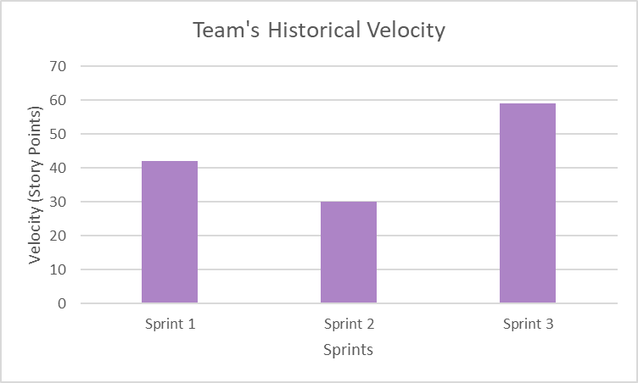
Team's Historical Velocity(average)

Slide 65
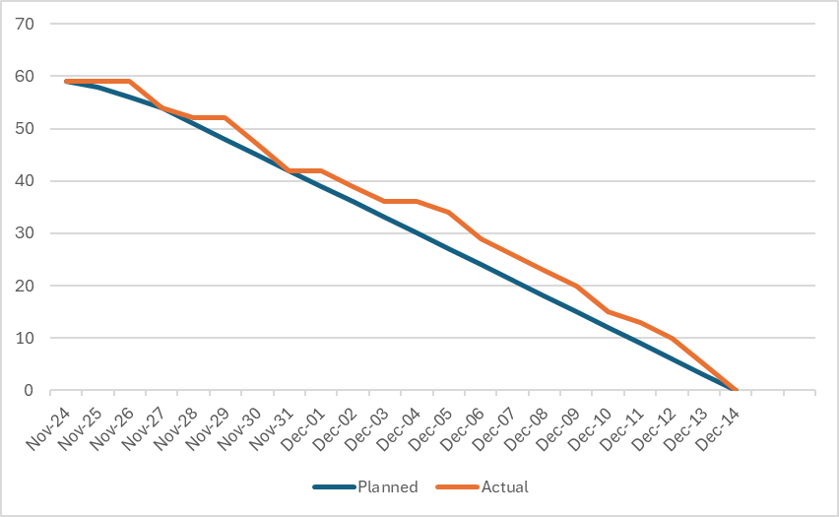
Burndown Chart

Slide 66
Completed / Committed Ratio
Completed Story Points = 59
Committed Story Points = 59
Completed/committed Ratio = 59/ 59
100%

Slide 67
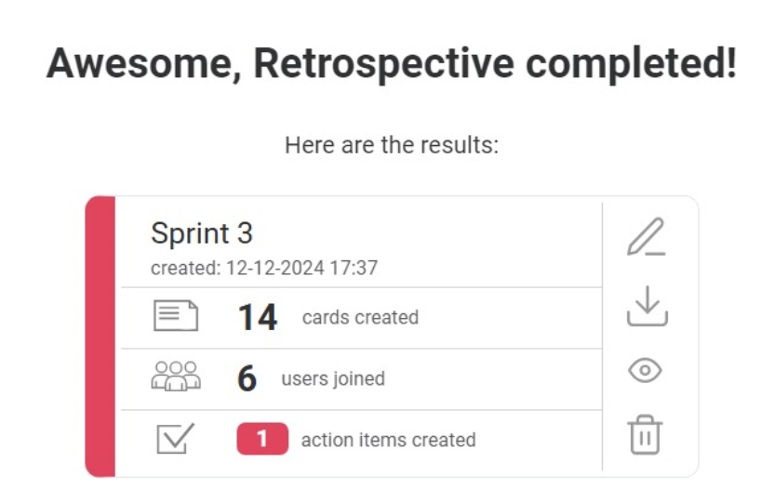
RETROSPECTIVE

Slide 68
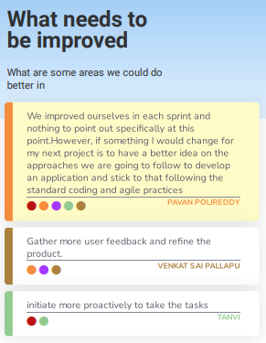
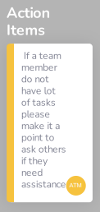
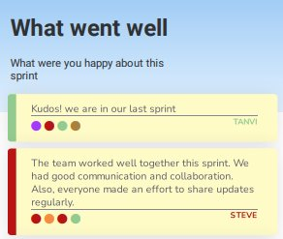
RETROSPECTIVE

Slide 69
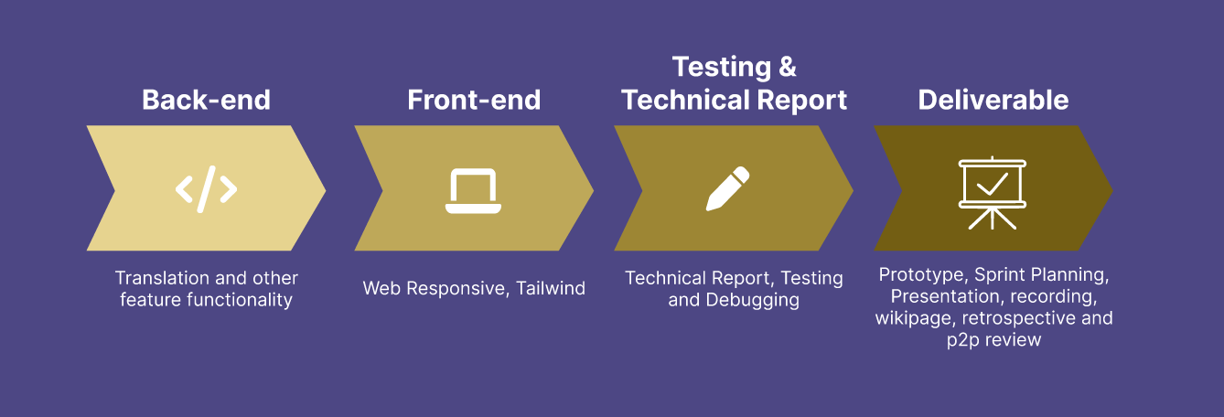
Timeline

Slide 70
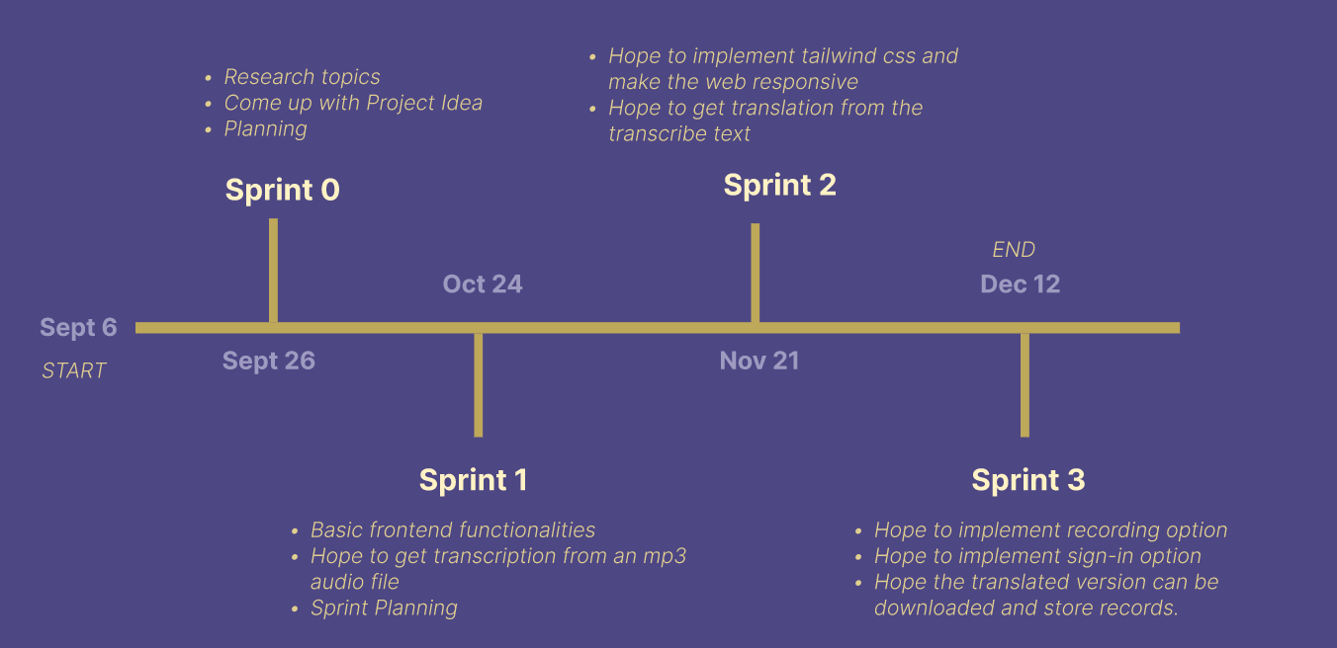
PROJECT SCHEDULE

Slide 71
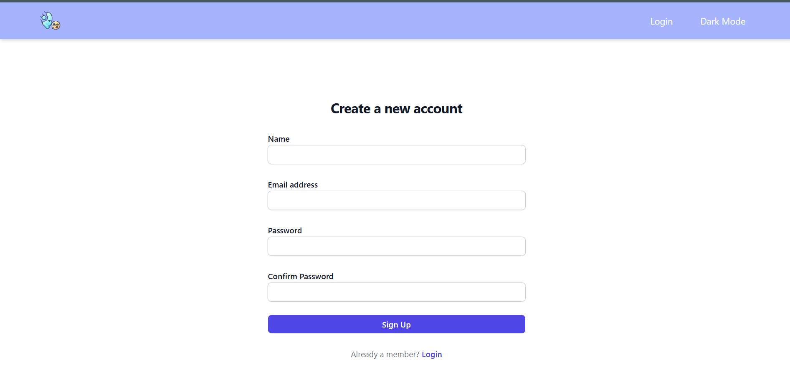
SpeakEZ Screenshot

Slide 72
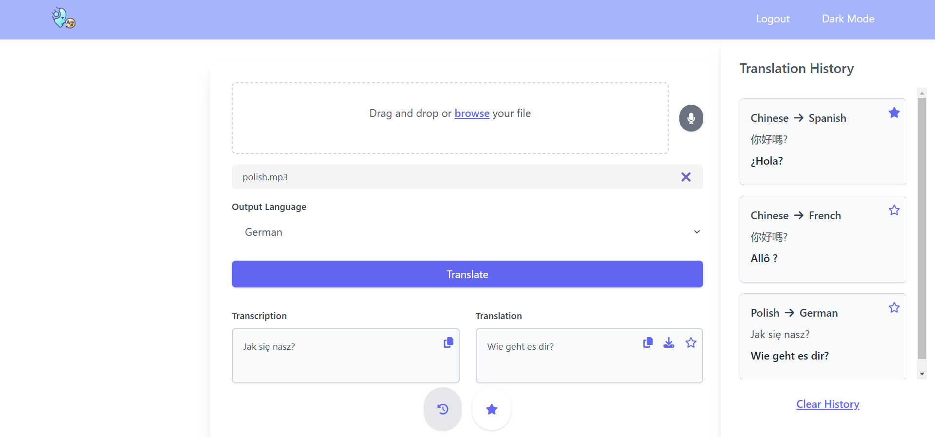
SpeakEZ Screenshot

Slide 73
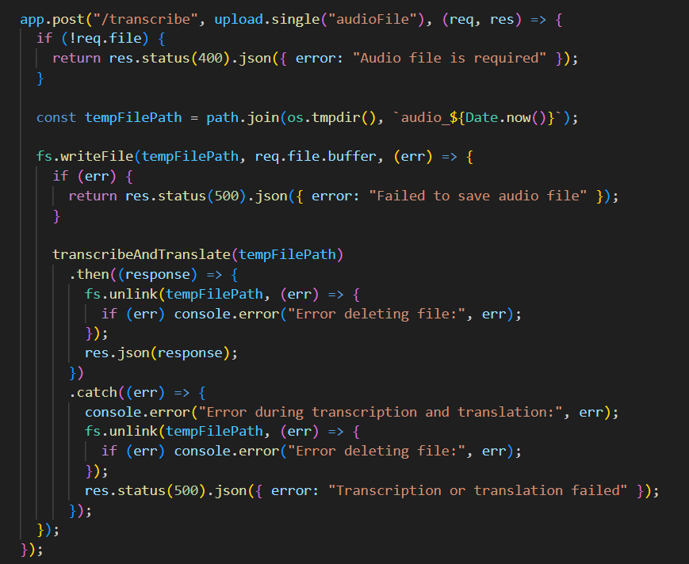
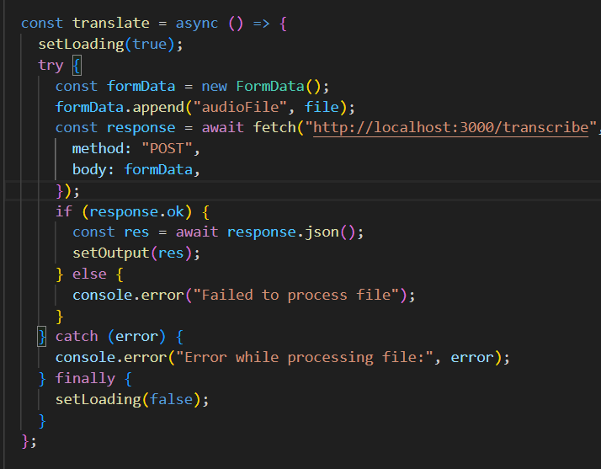
SpeakEZ AI Model Integration

Slide 74
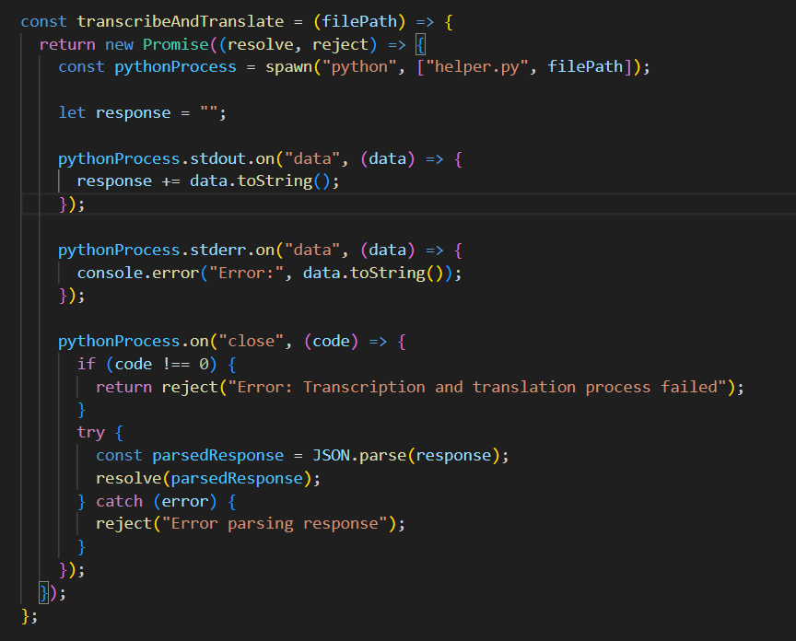
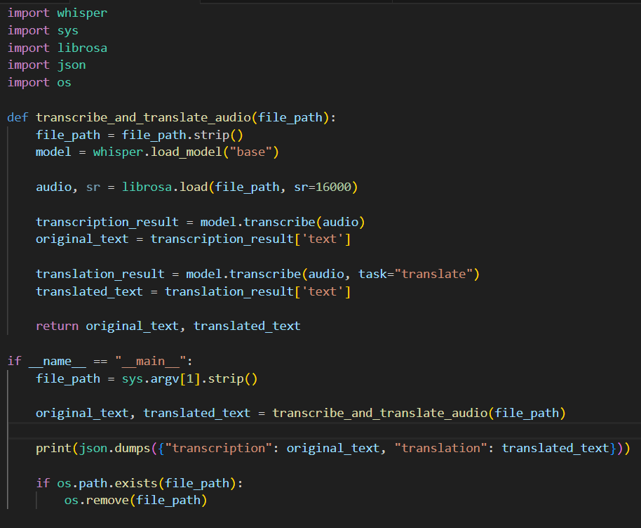
SpeakEZ AI Model Integration

Slide 75
SpeakEZ Demo
Sprint 1 Demo Link
Sprint 2 Demo Link
Sprint 3 Demo Link

Slide 76
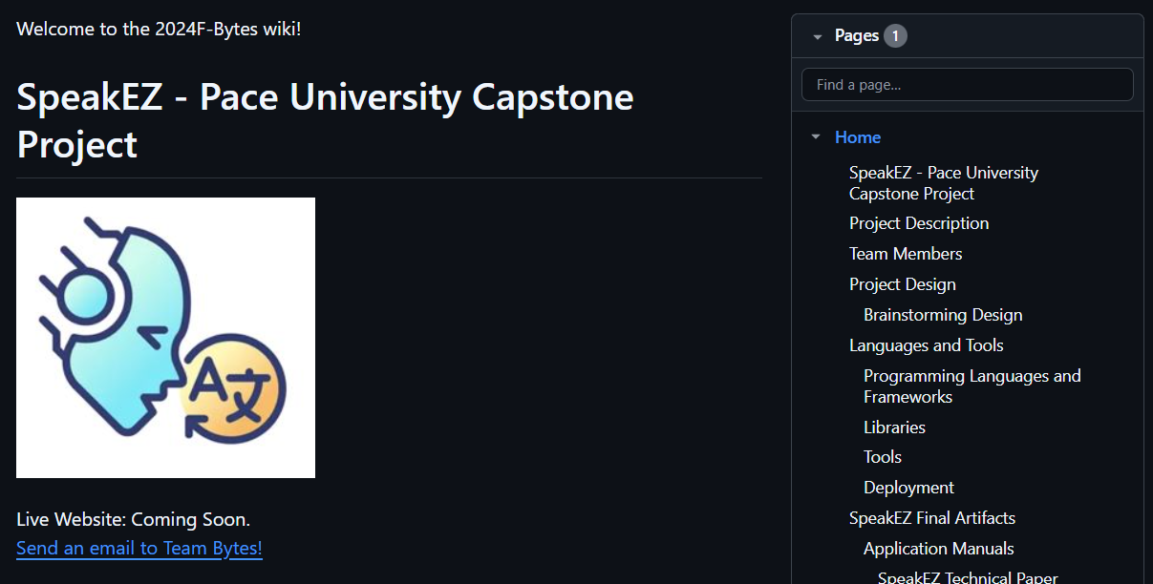
WIKIPAGE LINK
https://github.com/htmw/2024F-Bytes/wiki

Slide 77

THANK YOU!
Do you have any questions?

